Slide 1
Utilities Unit Cookbook Cost Estimating Refresher
May 6th, 2021

Slide 2
FOCUS OF THIS OVERALL EXCERCISE
Efficiency.
Meeting Schedule.
Allowing new people to use the CookBook while keeping a Standardized Final Deliverable.
***We are not focusing on how to develop the project specific inputs that go in the Cookbook. We are relying on each estimator to develop these inputs based on their project.****

Slide 3
Power Point Slide Direction
The purpose is to go step-by-step through the Cookbook Tool on SharePoint in order to produce two cost estimate numbers for each project:
Utility Relocation Cost Estimate
Utility Construction Cost Estimate
**We are not standardizing items or pricing. It is all adjustable and flexible. Prices in the Cookbook might work for your project and they might not.***

Slide 4
Cost Definitions
Utility Relocation Costs: Utility Relocation Construction that the NCDOT is fiscally responsible for. This relocation is performed outside of the highway contract.
For this exercise we are going to include power, communication, and gas as Utility Relocation Costs that the NCDOT is fiscally responsible for.
2. Utility Construction Costs: Utility relocation construction that the NCDOT performs for the Utility Owner inside the highway contract.
These are usually the “wet” utilities. Fiscal responsibility for relocation is not needed at this stage in estimation.

Slide 5
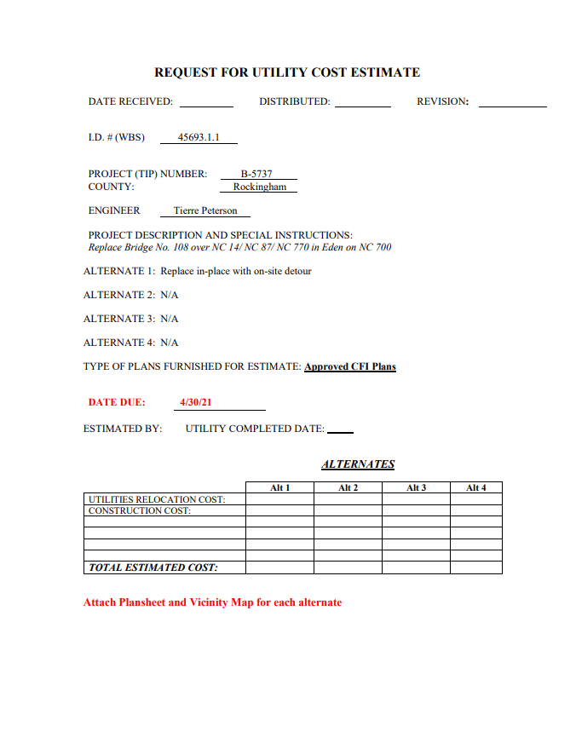
Utility Cost Estimate Request Form

Slide 6
TAB LIST
PROJECT DATA
UTILITY DESCRIPTION
POWER
TELEPHONE
GAS
WATER
SEWER
MISCELLANEOUS ITEMS
PROJECT TOTALS
REPORTS
POLE DESCRIPTION
POLE DATA

Slide 7
Project Data Tab

Slide 8
Project Data Tab

Slide 9
Project Data Tab
Must Check Box. This means the report is being run for Alternate No. 1
Checked Boxes Transfer to Report
Always Hit Refresh When Done

Slide 10
Utility Description Tab
Utility Description Tab is not needed to produce final estimate deliverable

Slide 11
Power Tab
Data Automatically Populated from Project Data Tab
Make sure “Reloc.” is selected for all power items

Slide 12
Power Tab
Pre-Populated “Power Pole Description” and “Cost Per Pole” Data. This can be used if you want to use it.

Slide 13
Power Tab
All 6 entry fields are completely adjustable

Slide 14
Power Tab
This is how you add items. When another item is added another blank line will auto-populate underneath it.
DON’T FORGET REFRESH
You can always look at the calculated data to make sure it lines up with entered data

Slide 15
Telephone Tab
Data Automatically Populated from Project Data Tab
Make sure “Reloc.” is selected for all telephone items
“Telephone Tab” setup matches the “Power Tab”
“Telephone Tab” is intended to capture all communication lines and appurtenances.

Slide 16
Telephone Tab
“Telephone Pole” does not mean a dedicated pole for telephone only
A “Two Cable Telephone Pole” is often a power pole with two cable attachments.
If one pole has power and telephone attached, it will go in the “Power Tab” and in the “Telephone Tab”

Slide 17
Telephone Tab
These are mainly buried communication lines. Description and pricing can be adjusted as needed.

Slide 18
Telephone Tab
DON’T FORGET REFRESH

Slide 19
Gas Tab
This should auto-populate from “Project Data” tab but doesn’t on this version. Enter it manually.
Make sure “Reloc.” is selected for all gas items
“Gas Tab” setup matches the “Power Tab” and “Telephone Tab”
DON’T FORGET REFRESH

Slide 20
Water Tab
Data Automatically Populated from Project Data Tab
Make sure “Const.” is selected for all water items
Once again “Water Tab” setup is consistent with previous Tabs

Slide 21
Water Tab
Double check big ticket items that were put in specific to a single project

Slide 22
Water Tab
DON’T FORGET REFRESH

Slide 23
Sewer Tab
Data Automatically Populated from Project Data Tab
Make sure “Const.” is selected for all sewer items

Slide 24
Sewer Tab
Project specific item pricing and sewer items can be adjusted

Slide 25
Sewer Tab
DON’T FORGET REFRESH

Slide 26
Project Totals Tab
NOTE A CONTINGENCY FACTOR HAS NOT BEEN ADDED TO THE “RELOCATION TOTALS” YET
THE CURRENT (5/06/21) CONTINGENCY FACTOR BEING ADDED TO THE SUM OF THE “RELOCATION TOTALS” IS 25%
PUT THE CONTINGENCY FACTOR AMOUNT IN MISCELLEANEOUS ITEMS
Utility Relocations not In the Highway Contract that the NCDOT is fiscally responsible for
Utility Relocations performed in the Highway Contract. Fiscal responsibility is not a factor here at this point

Slide 27
Work Outside the Cookbook to Calculate a 25% Contingency Factor
Use this amount. Now go back and put the amount in the “Miscellaneous Tab”

Slide 28
Miscellaneous Tab
Still $0.00!
There is no refresh button in the “Miscellaneous Tab”
3 ENTRIES
Go back to the “Project Data Tab” and hit the refresh button

Slide 29
Project Data Tab
HIT REFRESH TO GET CONTINGENCY INTO “RELOCATION TOTALS”

Slide 30
Miscellaneous Tab
Double Check “Miscellaneous Tab” for the value

Slide 31
Project Totals Tab
Double Check “Project Totals” Tab

Slide 32
Reports Tab
CLICK TO RUN REPORT WHICH PRODUCES YOUR DELIVERABLE

Slide 33
Utility Estimate Worksheet: The Deliverable
PRINT
Page 1
Use To Scroll Through All Pages of the Utility Estimate Worksheet

Slide 34
Utility Estimate Worksheet: The Deliverable
Page 2

Slide 35
Utility Estimate Worksheet: The Deliverable
Page 3

Slide 36
Utility Estimate Worksheet: The Deliverable
Page 4

Slide 37
Utility Estimate Worksheet: The Deliverable
Page 5

Slide 38
Utility Estimate Worksheet: The Deliverable
Page 6

Slide 39
Reports Tab
X
Not Needed For Final Estimate Deliverable

Slide 40
Pole Description Tab
Pole Description Tab is not needed to produce final estimate deliverable

Slide 41
Pole Data Tab
Pole Data Tab is not needed to produce final estimate deliverable

Slide 42
Helpful Hints
When you get an estimate finished PRINT IT OUT. Keep a paper hard copy of that estimate.
The CookBook was very thoroughly designed to offer a lot of options to an estimator.
If you get lost in the program, you can always: go back to the Utilities Unit SharePoint site, download this same version of the CookBook, and follow these steps to produce an estimate deliverable.

Slide 43
QUESTIONS?

